Slide 1
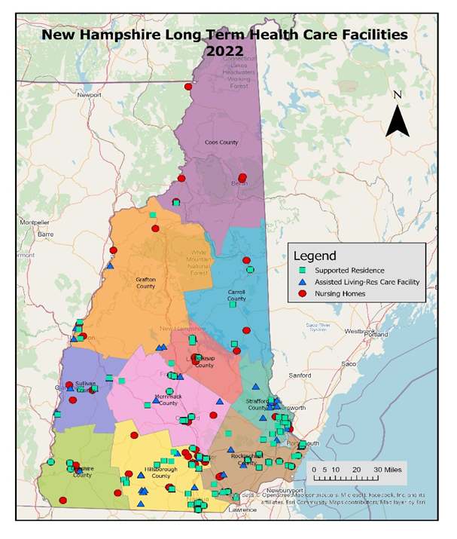
New Hampshire LTC Locational Demand Analysis
Maps and Charts
Issue 1
Jan 4, 2024

